Slide 1
Blazetoxicity:
Impact of U.S. Wildfires on Air Quality and Public Health
Mihir Harishankar Parab Rohit Sunil Patil Simran Abhay Sinha

Slide 2
01
Question 1
What factors might explain the geographic concentration of severe wildfires in certain regions?

Slide 3
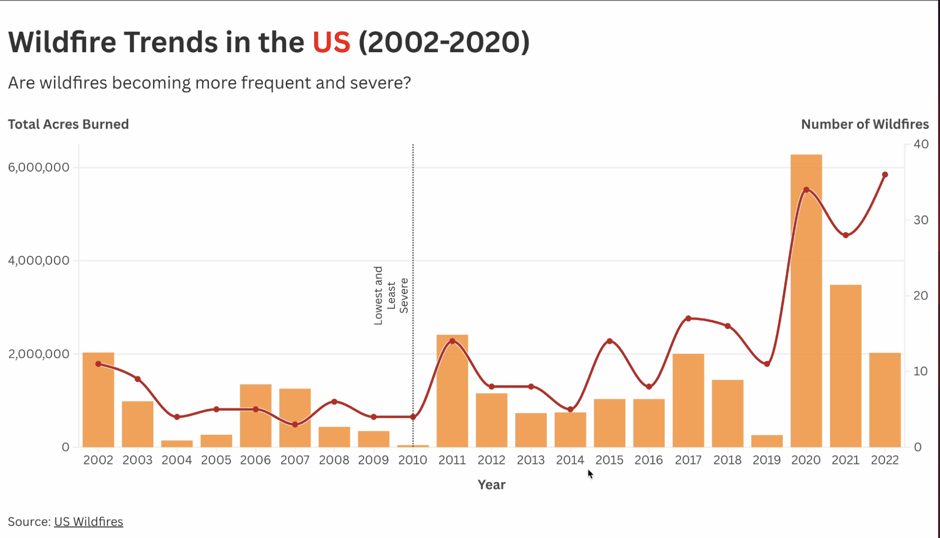
Wildfire Trends in the US (2002-2022)

Slide 4
Insights:
The line graph demonstrates patterns of wildfires in the U.S. between 2002 and 2020, with a definite increase in both the number of wildfires and number of acres burned over the years.
The period between 2002 and 2010 registered relatively fewer instances of wildfire activity, with 2010 registering the lowest intensity based on both criteria.
But since 2010, the number and intensity of wildfires climbed sharply, with acres burned as high as approximately 6 million in 2020 and wildfires numbered nearly 40.
This trend indicates growing intensity and frequency of the wildfires, almost certainly the result of a mix of reasons such as climate change, drought, and human activity, and increasingly severe environmental and public health concerns.

Slide 5
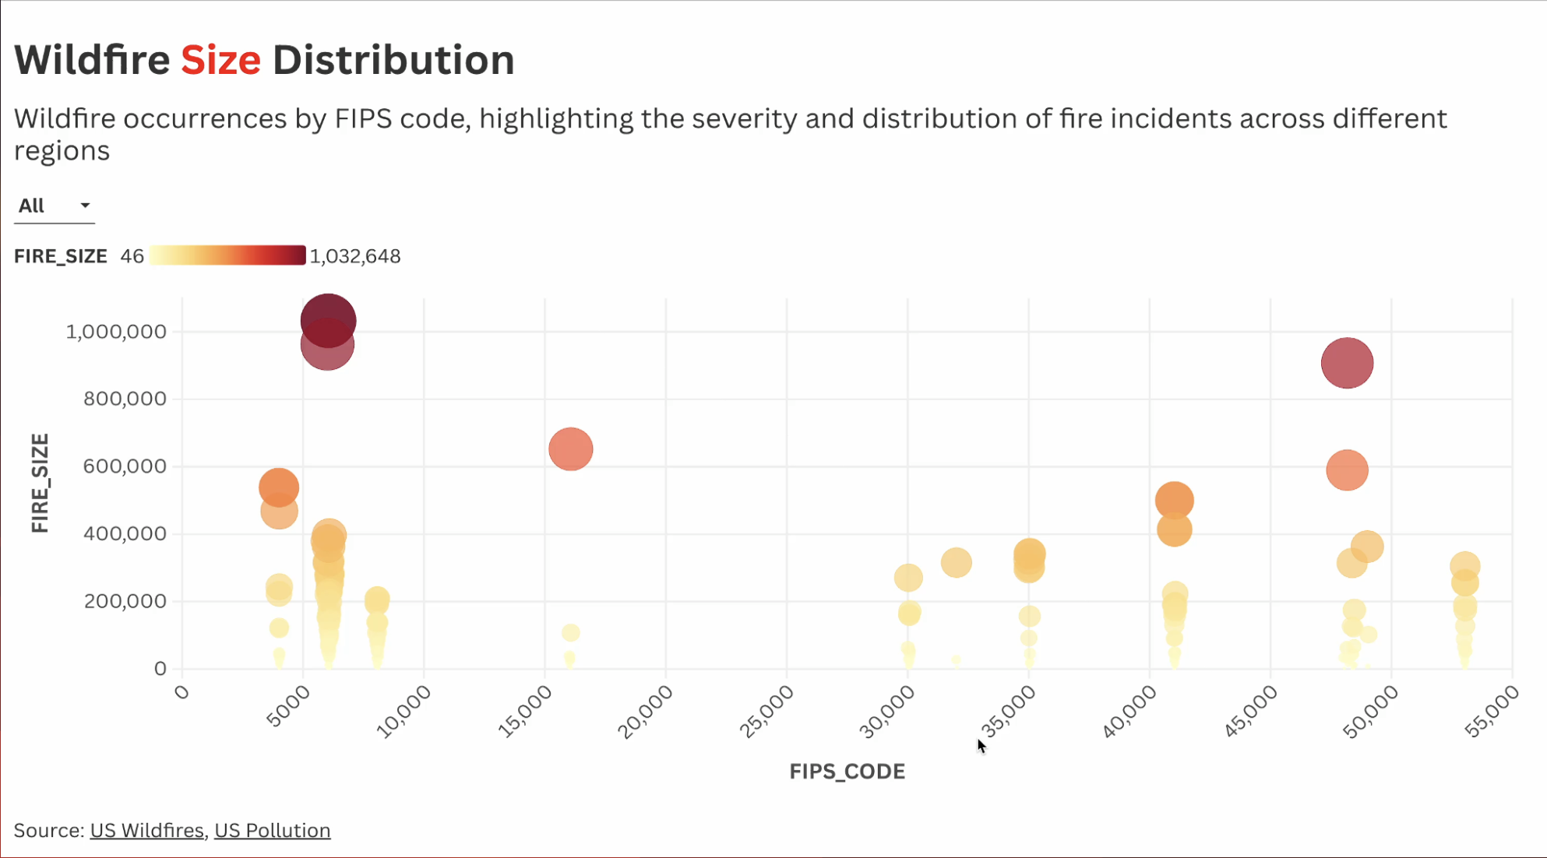
Wildfire Trends in the US (2002-2022)

Slide 6
Insights:
The scatter plot titled Wildfire Size Distribution visually illustrates wildfire events by FIPS codes, highlighting the size and geographical extent of fire incidents.
Every bubble symbolizes a wildfire, with intensity of color and radius indicating fire size.
The darker and bigger bubbles signify more severe fires, with some exceeding 1,000,000 acres.
The visualization shows that there are certain regions (certain FIPS codes) that have disproportionately large wildfires compared to others.
This visualization emphasizes the uneven severity of wildfires by region and underscores the necessity for targeted fire management in high-risk areas.
The geographic concentration of wildfire events calls for targeted interventions in these high-risk areas to reduce the disproportionate impact of severe wildfires.

Slide 7
02
Question 2
What proportion of AQI levels fall into unhealthy categories, and how does this correlate with wildfire activity?

Slide 8
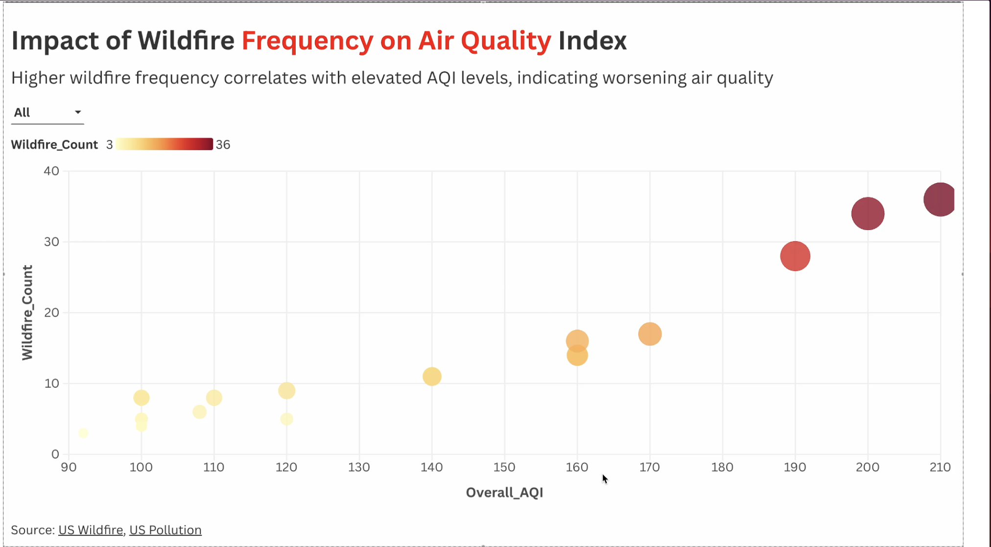
Wildfire Trends in the US (2002-2022)

Slide 9
Insights:
The scatter plot shows the relationship between wildfire frequency and air quality as measured by the Air Quality Index (AQI).
The plot shows a clear trend whereby higher wildfire frequency is associated with elevated AQI values, indicating worse air quality.
The color intensity of the data points indicates the frequency of wildfires, where darker colors indicate higher frequency.
This visualization highlights the strong influence of increased wildfire occurrence on declining air quality, with the implicit suggestion of the need for effective measures against both wildfire management and its environmental consequences.

Slide 10
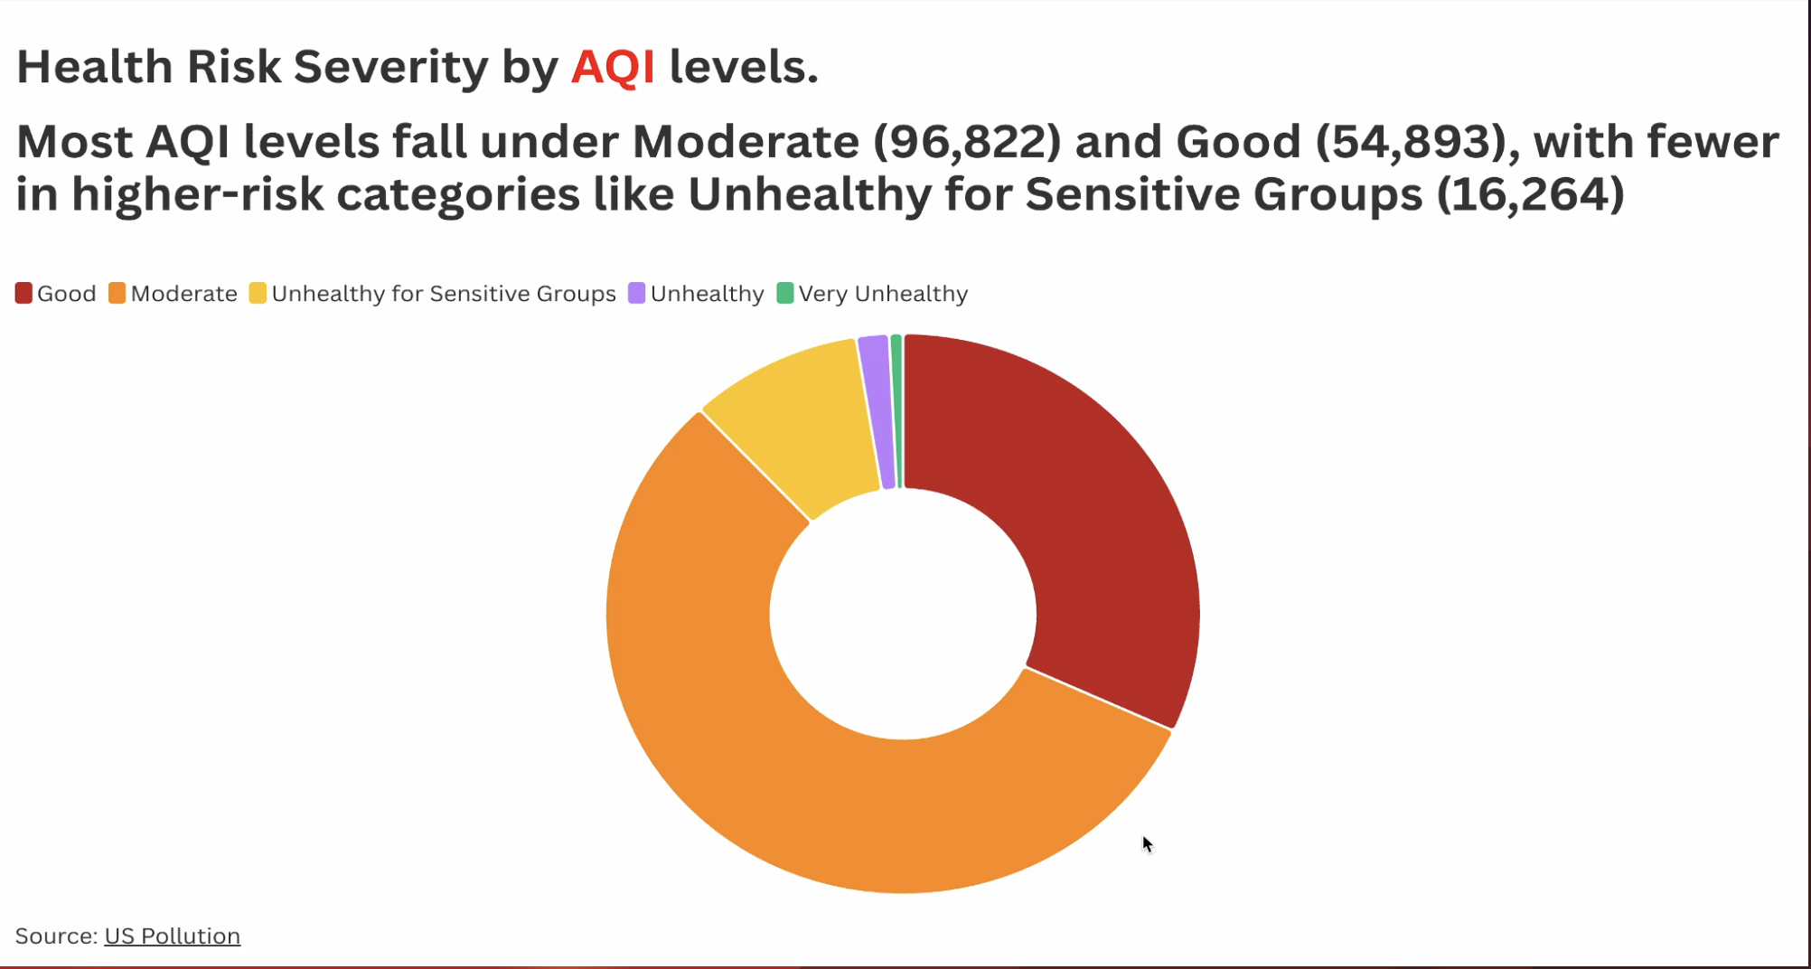

Slide 11
Insights:
The donut chart shows the level of health risk based on Air Quality Index (AQI) levels. It shows that the majority of AQI readings are in the Moderate (96,822) and Good (54,893) categories, representing relatively low health risks.
Although small but appreciable quantities are categorized as Unhealthy for Sensitive Groups (16,264), with relatively little occurrence in the Unhealthy and Very Unhealthy categories.
This trend confirms that although the bulk of the air quality conditions are acceptable, there may nevertheless be a large risk of adverse health effects from poorer air in some groups.
The trend highlighted by the donut chart indicates that while air quality might seem acceptable on a large scale, specific vulnerable populations face real risks.
Most AQI readings are in safer categories, the risk to sensitive groups is significant, emphasizing the importance of taking action to protect vulnerable populations from the adverse effects of poorer air quality, especially during events like wildfires.

Slide 12
03
Question 3
How do the primary causes of wildfires correlate with the geographic distribution of wildfire danger zones in California?

Slide 13
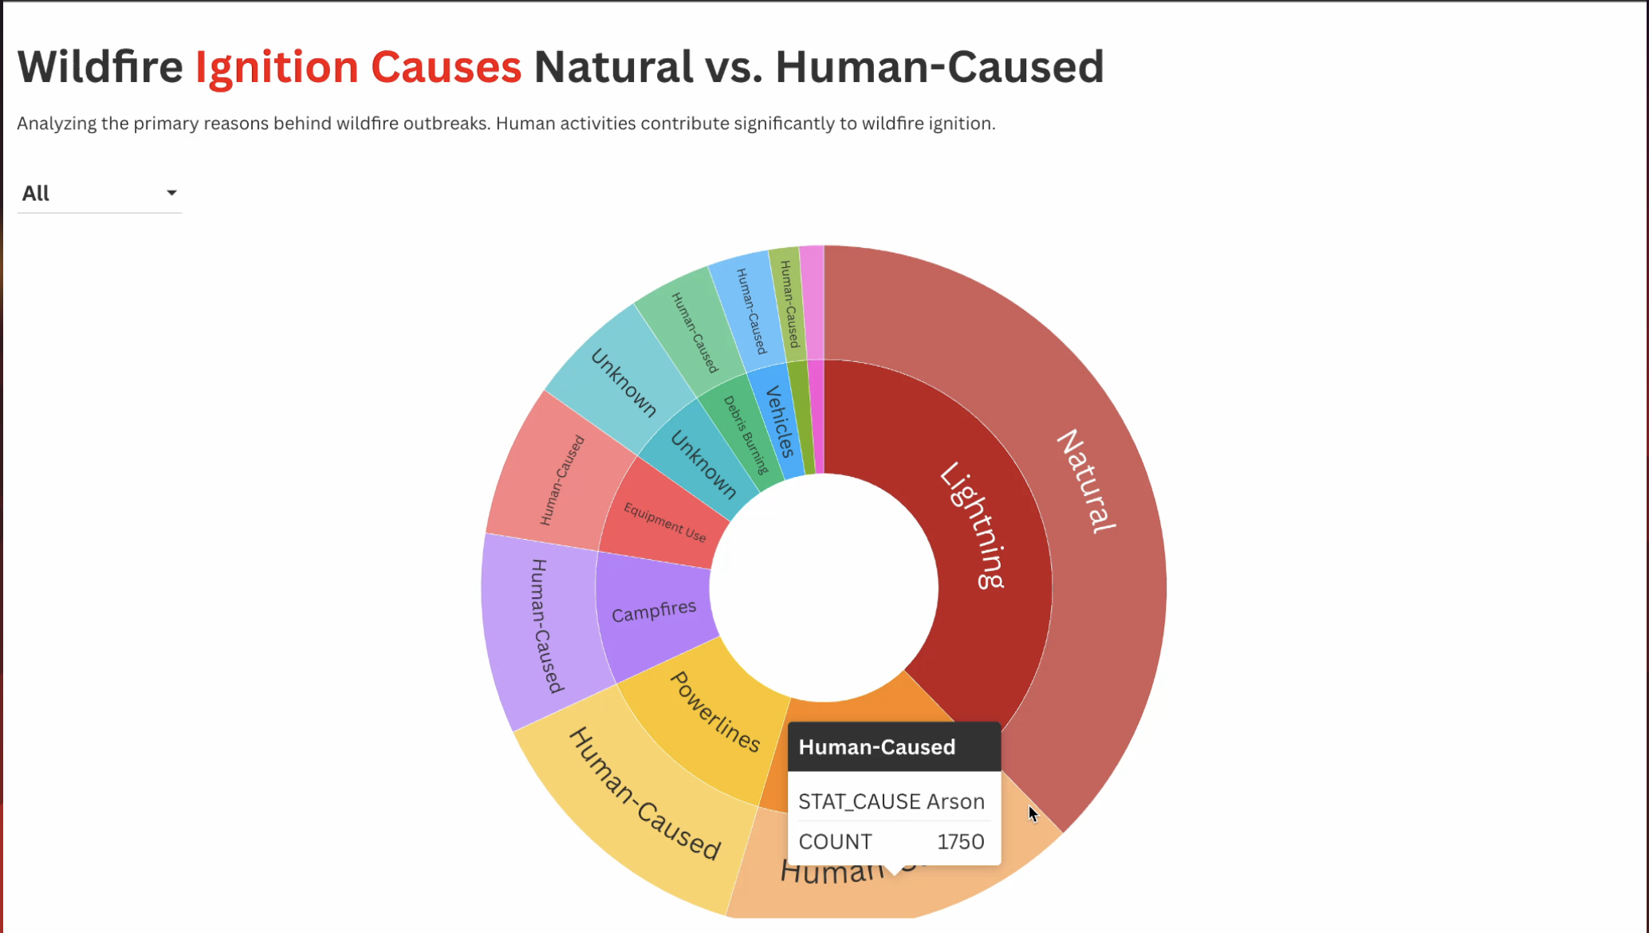
Wildfire Trends in the US (2002-2022)

Slide 14
Insights:
The Wildfire Ignition Causes sunburst chart is a clear categorization of the primary causes of wildfire occurrence, distinguishing between natural and human-caused fires.
Lightning is the pre-eminent natural cause, followed by campfires, equipment use, powerlines, and arson as dominant human causes.
The visualization emphasizes the overwhelming role of human actions in causing wildfires and the necessity of prevention.
The interactive feature on the chart allows drilling down into specific causes, making it a valuable resource for wildfire causation education.

Slide 15
AREA WITH MORE FIRES
California

Slide 16
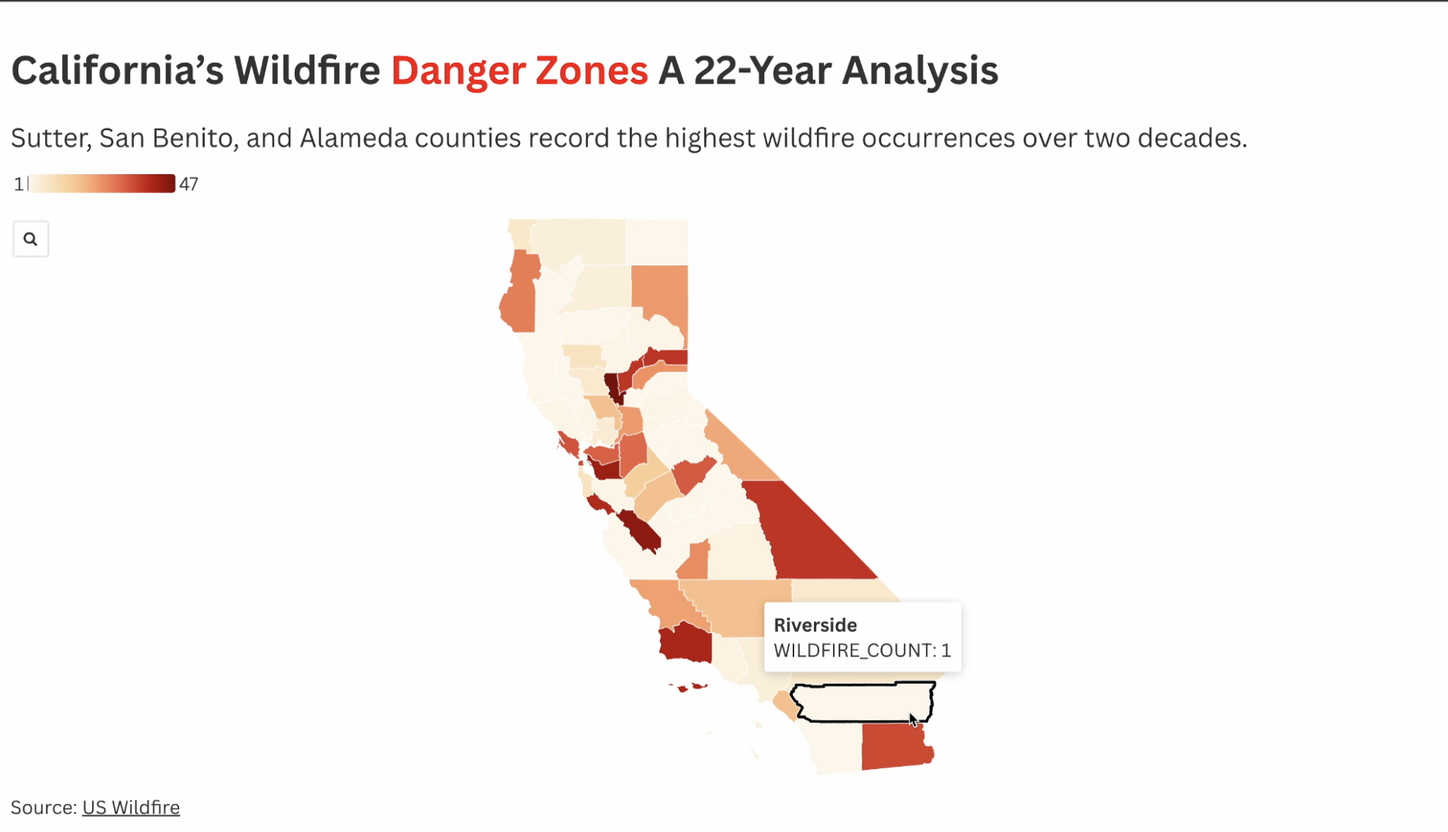
Wildfire Trends in the US (2002-2022)

Slide 17
Insights:
The wildfire risk zones of California over a span of 22 years come out in the map, with counties shaded according to the frequency of occurrence of wildfires.
Sutter, San Benito, and Alameda counties are the locations where the highest wildfire frequency is occurring, which has been pinpointed in the darkest red.
Shades indicate ranges of wildfire possibility across the state, some places being far more likely for wildfires to occur.
This map brings attention to the need for concerted efforts in prevention and mitigation of the most wildfire-infested counties.
By focusing on education and proactive fire management strategies, particularly in mitigating human-caused fires, we can significantly reduce the frequency and severity of wildfires in vulnerable areas.

Slide 18
CONCLUSION
Question 01
Question 02
Question 03
The trend of increasing wildfire frequency and severity highlights the urgent need for preventive measures, policy changes, and climate action to mitigate their impact.
Wildfires are predominantly caused by Human activities. Prevention and mitigation efforts need to focus on implementing policies aimed at reducing California fires.
AQI levels are directly impacted by the frequence of wildfires. Effective wildfire management are necessary to reduce the health risks

Slide 19
THANK YOU

